Slide 1

HOUSING: PRICE PREDICTION
Submitted by:
ANKIT DADARWALA
ACKNOWLEDGMENT
This includes mentioning of all the references, research papers, data sources, professionals and other resources that helped you and guided you in completion of the project.
https://www.kaggle.com/harshjain123/feature-engineering-from-scratch using this website for Features selection, Missing value handling, Assumption, Statistical analysis.
https://www.analyticssteps.com/blogs/introduction-statistical-data-analysis used this website for statistics theory concept and study about data set.
https://www.codespeedy.com/p-value-in-machine-learning-python/ use for statistics tools like hypothesis test, p- values for features selection and features analysis.
Use Some Googles, YouTube channels and Stack overflow for coding.

Slide 2
INTRODUCTION
Problem Statement:
Houses are one of the necessary need of each and every person around the globe and therefore housing and real estate market is one of the markets which is one of the major contributors in the world’s economy. It is a very large market and there are various companies working in the domain. Data science comes as a very important tool to solve problems in the domain to help the companies increase their overall revenue, profits, improving their marketing strategies and focusing on changing trends in house sales and purchases. Predictive modelling, Market mix modelling, recommendation systems are some of the machine learning techniques used for achieving the business goals for housing companies. Our problem is related to one such housing company.
A US-based housing company named Surprise Housing has decided to enter the Australian market. The company uses data analytics to purchase houses at a price below their actual values and flip them at a higher price. For the same purpose, the company has collected a data set from the sale of houses in Australia. The data is provided in the CSV file below.
The company is looking at prospective properties to buy houses to enter the market. You are required to build a model using Machine Learning in order to predict the actual value of the prospective properties and decide whether to invest in them or not. For this company wants to know:
Which variables are important to predict the price of variable?
How do these variables describe the price of the house?

Slide 3
Business Goal
You are required to model the price of houses with the available independent variables. This model will then be used by the management to understand how exactly the prices vary with the variables. They can accordingly manipulate the strategy of the firm and concentrate on areas that will yield high returns. Further, the model will be a good way for the management to understand the pricing dynamics of a new market.
Conceptual Background of the Domain Problem
House is very necessary thing on earth for each n every person for stay in and spend time with family or friends. On now today property prices is very high due real estate growth and as better arcatures are facilitate with like luxurious house or flats and also Hi-tech gadgets like automation of electrical equipment other facilities like extra spaces for vehicles, Storage room, 3BHK,4BKH, basement area, gardens, Bathrooms with attached rooms, more kitchen spaces with optimize with kitchen appliances and good-looking kitchens with latest hi-tech furniture. Also, facility with individual bedrooms like children’s bedrooms, master bedrooms
In flats also proving penthouse with garden home looks beautiful, Duplex flats also available for big family, as well Fire safety facilities ,Other facilities like gas line provided by Govt, Electricity supplies, Water supplies for 24Hours,pool facility etc…
Motivation for the Problem Undertaken
Now days House buys are easy from the ecommerce websites like 99acres.com, housing.com, magicbricks.com etc. But for the person who not familiar with real estate and does not know how find exact value of the house, and they hired broker for that to find house according to their budgets and pay them fess too. So for that Make Machine Learning algorithm that find the price of house by given features(description of house) like
Lot area, frontage area, location of house, condition of house, construction year, Any modification done/not, foundation type, total square feet, usable square feet of house, No. of floors, No. of bedrooms ,total rooms, kitchen areas, pool facility ,water and gas facility etc….

Slide 4
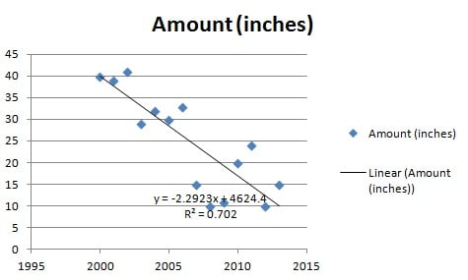
Analytical Problem Framing
Mathematical/ Analytical Modelling of the Problem
We have Use two linear models for problems like Linear Regression and Logistic Regression, they apply according to target columns so if we have Binary or Class column, we use Logistic Regression and If we have Continuous feature target column use Linear Regression.
Why use Linear Relationships?
Linear relationships, i.e. lines, are easier to work with and most phenomenon are naturally linearly related. If variables aren’t linearly related, then some math can transform that relationship into a linear one, so that it’s easier for the researcher (i.e. you) to understand.

Slide 5
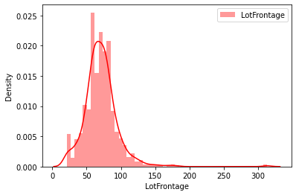
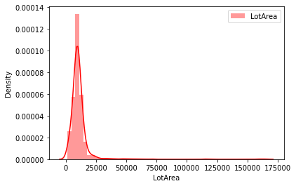
Distribution Plot of Skewed Features in dataset

Slide 6
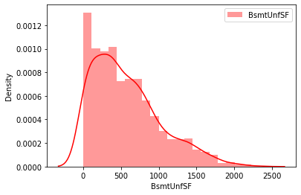
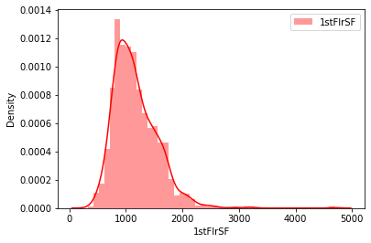
Distribution Plot of Skewed Features in dataset

Slide 7
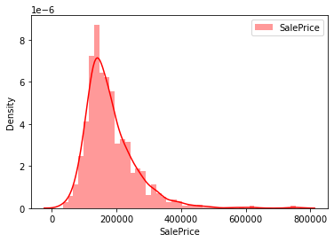
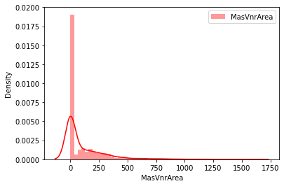
Distribution Plot of Skewed Features in dataset

Slide 8
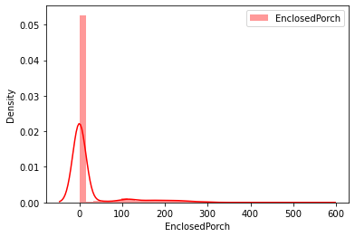
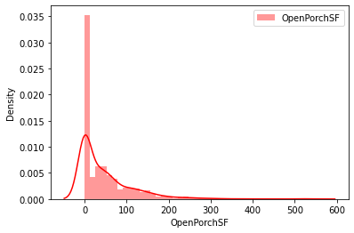
Distribution Plot of Skewed Features in dataset
In above graph all features have left skewed data in that mean is greater than median values.

Slide 9
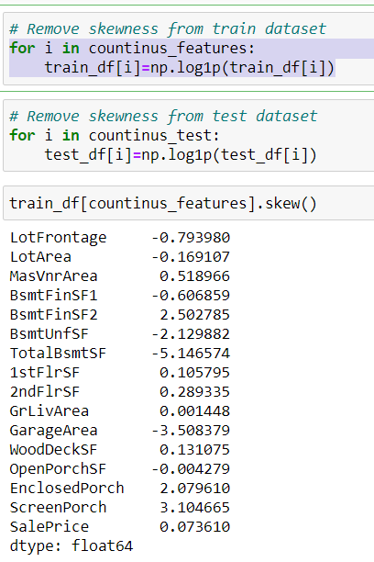
Remove Skewness
In code apply for remove skewness from the continues features
In that skewness remove by log method

Slide 10
Data Inputs- Logic- Output Relationships
Columns correlations
MSSubClass -0.060775
LotFrontage 0.323851
LotArea 0.249499
OverallQual 0.789185
OverallCond -0.065642
YearBuilt 0.514408
YearRemodAdd 0.507831
MasVnrArea 0.460535
BsmtFinSF1 0.362874
BsmtFinSF2 -0.010151
BsmtUnfSF 0.215724
TotalBsmtSF 0.595042
1stFlrSF 0.587642
2ndFlrSF 0.330386
LowQualFinSF -0.032381
GrLivArea 0.707300
BsmtFullBath 0.212924
BsmtHalfBath -0.011109
FullBath 0.554988
HalfBath 0.295592
BedroomAbvGr 0.158281
KitchenAbvGr -0.132108
TotRmsAbvGrd 0.528363
Fireplaces 0.459611
GarageYrBlt 0.453840
GarageCars 0.628329
GarageArea 0.619000
WoodDeckSF 0.315444
OpenPorchSF 0.339500
EnclosedPorch -0.115004
3SsnPorch 0.060119
ScreenPorch 0.100284
PoolArea 0.103280
MiscVal -0.013071
MoSold 0.072764
YrSold -0.045508
SalePrice 1.000000
Name: SalePrice, dtype: float64
To check relation with target column used a heatmap for visualization and correlation method to which particular feature affect positively to target and which feature affect target negatively, and also know how to individual feature correlated to each other so check multi-collinearity by Variance inflation factor.
Now from below code “ Lotfrontage ,Lotarea, OverallQual, Yearbuilt, YearRemodAdd, MasVnrArea, BsmtFinSF1, TotalBsmtSF, 1stFlrSF, GrLivArea, FullBath, TotRmsAbvGrd, Fireplaces, GarageYrBlt, GarageCars, GarageArea, WoodDeckSF “ are highly Positive correlated with target columns.
“LotShape,ExterQual,BsmtQual,HeatingQC,KitchenQual,GarageType,GarageFinish” are negatively correlation with House price.

Slide 11
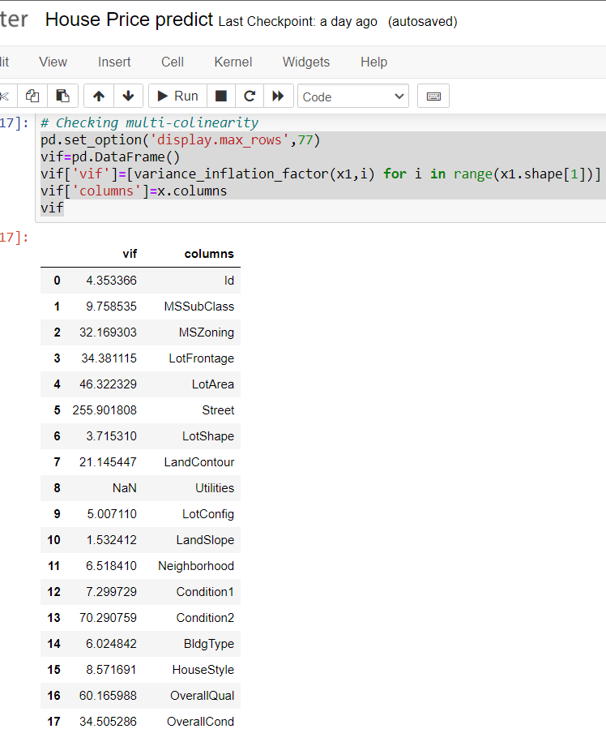
For the Multicollinearity we check VIF score of features
From that table pic we show Vif score of individual features and with reference with heatmap we check which is more related with target columns and drop other which less correlated.
MSSubclass and Bldgtype are highly collinear with each other and have equal values so choose one from that.
OverallQual and Yearbult negatively with each other because year spend house quality decrease
OverallQual and YearRemodAdd are positive correlated with each other.
Extrior1st and Exterior2nd are highly correlated with each other have Vif score 38.4 and 36.4 accordingly equally correlated with target so we assume one material use in house drop Exterior2nd
GarageCars and Garagearea are high correlated with each other and also positive with target column so we assume NO.of cars parked in garage are necessary so drop other one.
Consider that multicollinear columns that drop that column “MSSubClass','Condition1','TotRmsAbvGrd','Utilities','YearBuilt','2ndFlrSF','Exterior2nd','BsmtUnfSF','GarageArea','OverallCond”

Slide 12
State the set of assumptions (if any) related to the problem under consideration
Data is missing completely at random (MCAR)
The missing observations, most likely look like the majority of the observations in the variable (aka, the mean/median)
If data is missing completely at random, then it is fair to assume that the missing values are most likely very close to the value of the mean or the median of the distribution, as these represent the most frequent/average observation.
Frequency Count Imputation (Mode)
Frequent category imputation—or mode imputation—consists of replacing all occurrences of missing values (NA) within a variable with the mode, or the most frequent value.
This method is suitable for numerical and categorical variables, but in practice, we use this technique with categorical variables.
You can use this method when data is missing completely at random, and no more than 5% of the variable contains missing data
Min-Max Scaler
The MinMax scaler is one of the simplest scalers to understand. It just scales all the data between 0 and 1.
FORMULA: x_scaled = (x – x_min)/(x_max – x_min)
Feature Selection Methods:
1). Univariate Selection 2).Feature Importance 3).Correlation Matrix with Heatmap
We use Correlation Matrix with Heatmap
Correlation states how the features are related to each other or the target variable. Correlation can be positive (increase in one value of feature increases the value of the target variable) or negative (increase in one value of feature decreases the value of the target variable).Heatmap makes it easy to identify which features are most related to the target variable, we will plot heatmap of correlated features using the seaborn library..

Slide 13
Required Libraries Used For Dataset
import pandas as pd
import numpy as np
import matplotlib.pyplot as plt
%matplotlib inline
import seaborn as sns
import pandas_profiling as ProfileReport
import IPython.display as display
import missingno as msno
import warnings
warnings.filterwarnings('ignore')
from sklearn.impute import SimpleImputer
from sklearn.preprocessing import OrdinalEncoder,MinMaxScaler
from statsmodels.stats.outliers_influence import variance_inflation_factor
from sklearn.linear_model import LinearRegression,SGDRegressor,Lasso,Ridge,BayesianRidge,ElasticNet
from sklearn.tree import DecisionTreeRegressor
from sklearn.svm import SVR
from sklearn.neighbors import KNeighborsRegressor
from xgboost import XGBRegressor,XGBRFRegressor
from sklearn.ensemble import RandomForestRegressor,GradientBoostingRegressor,AdaBoostRegressor,BaggingRegressor
from sklearn.model_selection import train_test_split,cross_val_score,GridSearchCV,KFold
from sklearn.metrics import r2_score,mean_absolute_error,mean_squared_error
from sklearn.feature_selection import SelectFromMode

Slide 14
Testing of Identified Approaches (Algorithms)
LinearRegression()
DecisionTreeRegressor()
SVR(kernel="linear",C=0.1)
KNeighborsRegressor(n_neighbors=10)
Lasso(alpha=0.001,fit_intercept=True,normalize=False,precompute=True)
Ridge(alpha=1,solver="saga")
ElasticNet(alpha=0.001,max_iter=10)
BayesianRidge()
SGDRegressor()
XGBRegressor()
XGBRFRegressor()
RandomForestRegressor()
AdaBoostRegressor()
GradientBoostingRegressor()
BaggingRegressor()

Slide 15
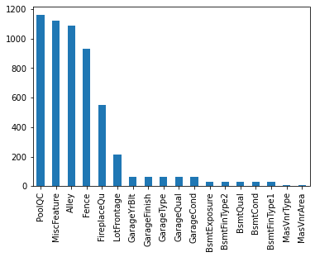
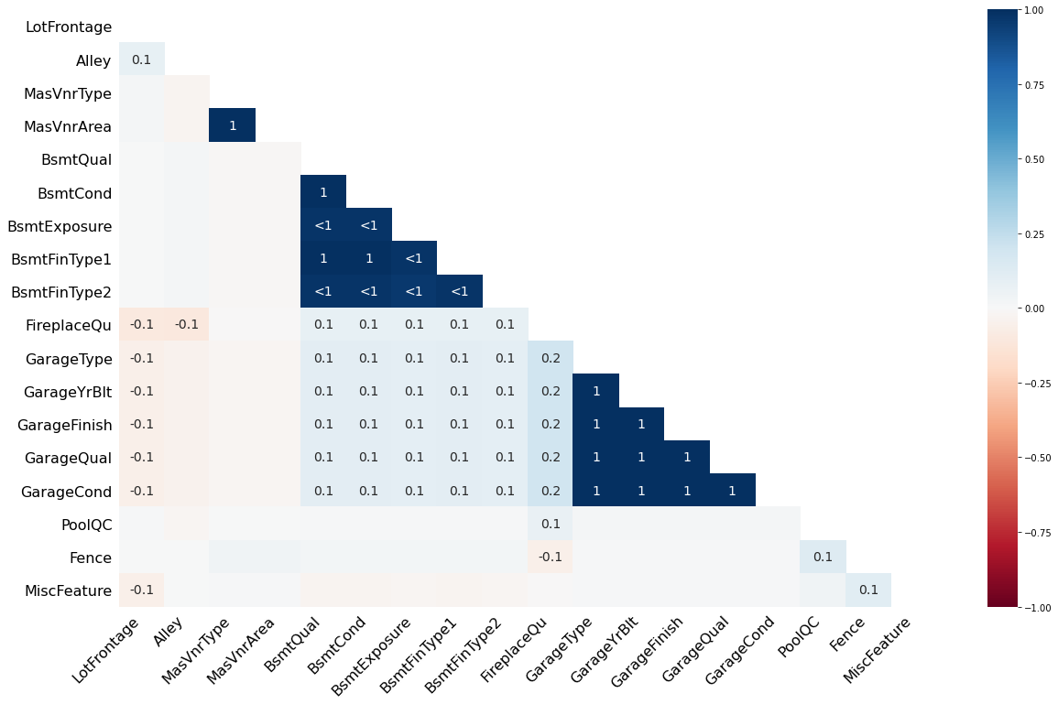
Visualizations
Count plot , Bar plot Distribution plot , Scatter plot
Box plot , Correlation matrix Heatmap , Line plot
Above graph represent the Missing values and correlation with missing values with each other’s.
PoolQC, MiscFeature, Alley, Fence have more 50% to 98% Null values so drop that column also they columns have not correlation with others.

Slide 16
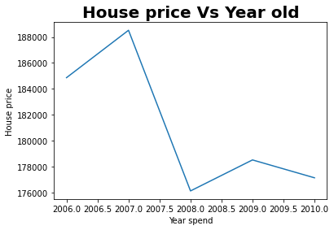
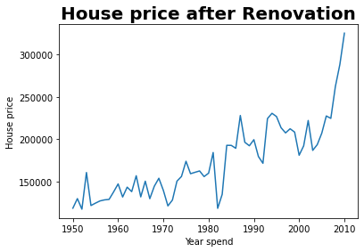
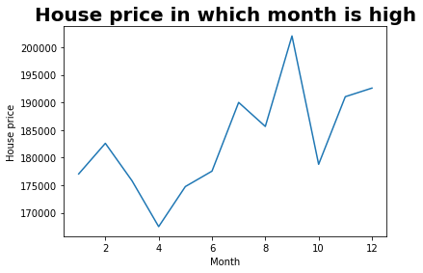
Visualizations
Above graph show the House price with respect to year olds In 1st graph saw that price continues decrease with year’s old.
2nd graph we saw price increasing with Renovation done in year.
3rd graph most of 4 to 10 months period price is continuously increasing.

Slide 17
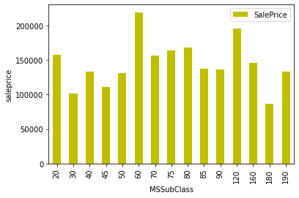
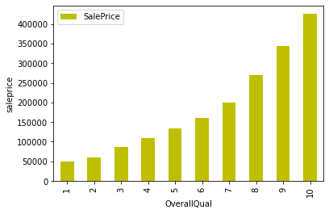
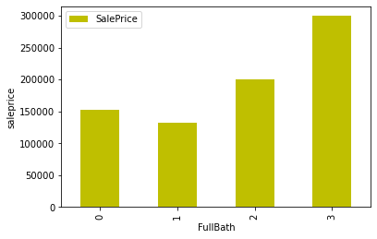
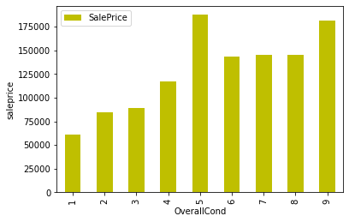
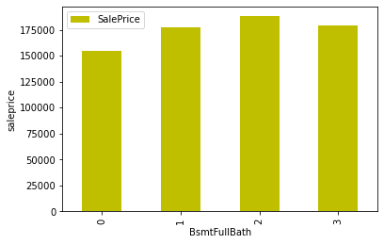
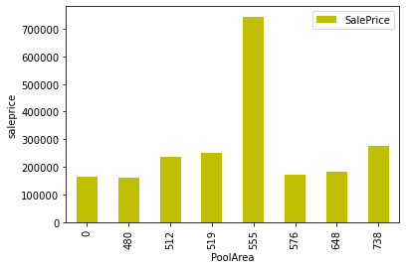
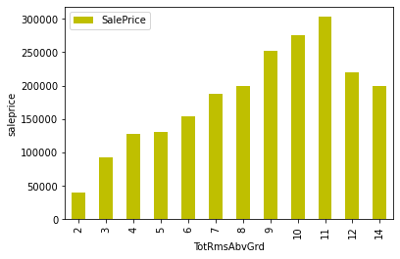
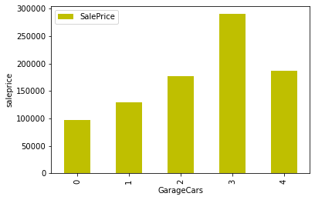
Graph show house sales price affect by discrete features of data set
2-STORY 1946 & NEWER and 1-STORY PUD (Planned Unit Development) - 1946 & NEWER have max high house price up 200000/-
2-STORY 1945 & OLDER,2-1/2 STORY ALL AGES, SPLIT OR MULTI-LEVEL, SPLIT FOYER, DUPLEX - ALL STYLES AND AGES have Average price around 150000/-
Over all Quality increase affect price positively that increase price as well
Over all condition between 5 to 10 high prices above 125000/-
Bsmtfullbath and Bsmthalfbath doesn’t affect price much have same
3 Fullbath has max price
Total rooms increase price also increase at 10 rooms than price decrease by increase rooms
Most of 3 cars park in garage space have high price
Poolarea 555 area have max price

Slide 18
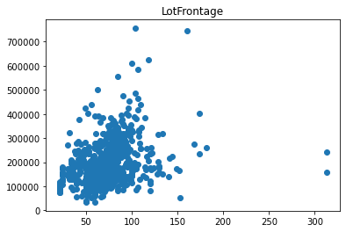
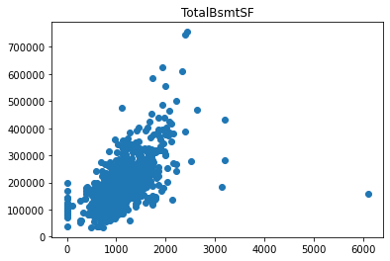
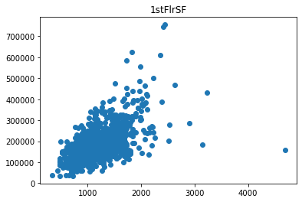
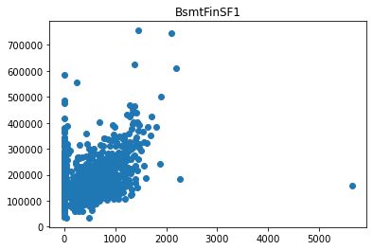
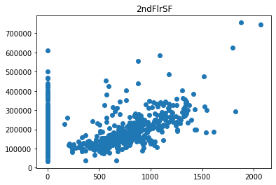
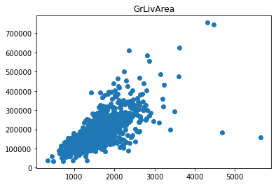
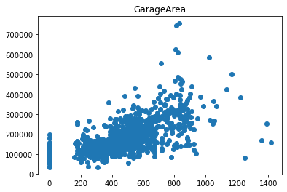
Graph show house sales price with continues features of data set
From the scatter plot we saw that price linearly increase with some features like,WoodDeckSF Garage area, Grlivearea, 1stflrSF, 2ndfltSF, TotBsmtSF, LotFrontage.

Slide 19
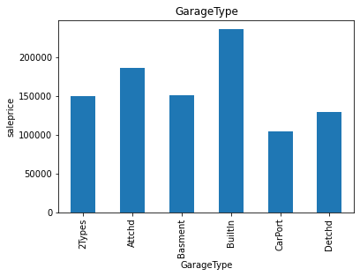
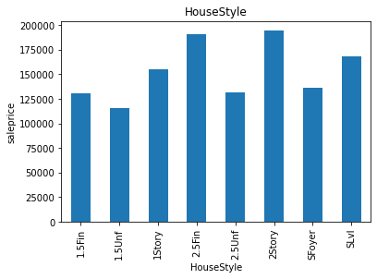
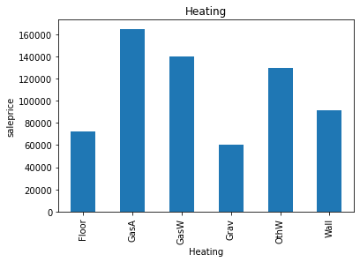
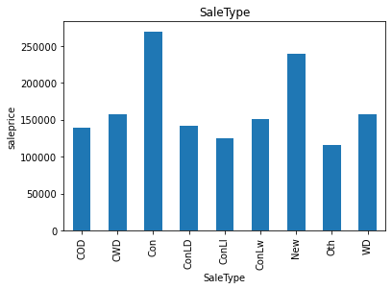
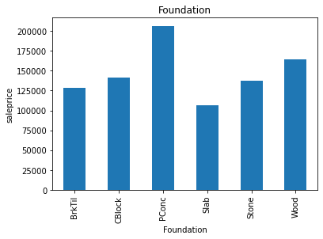
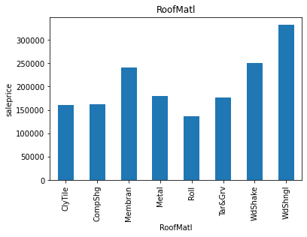
Graph show house sales price affect by Categorical features of data set

Slide 20
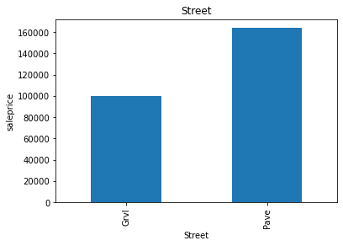
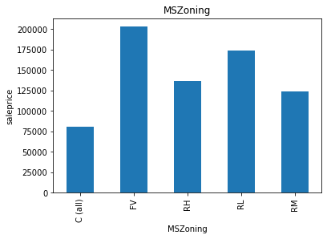
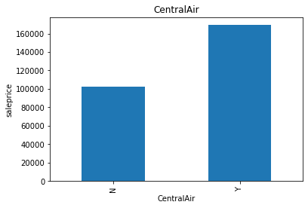
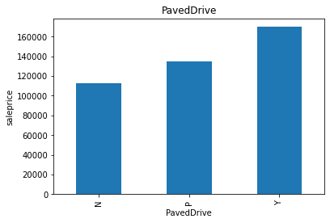
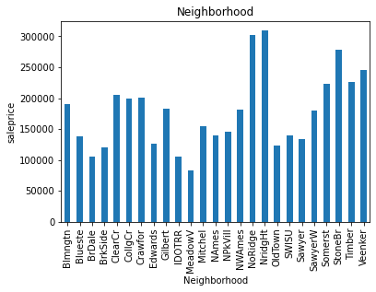
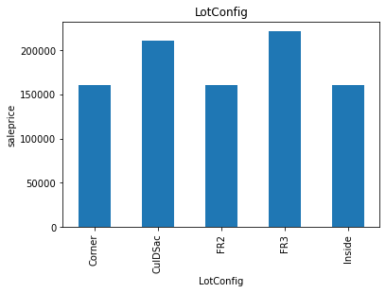
Graph show house sales price affect by Categorical features of data set

Slide 21
Graph show house sales price affect by Continues features of data set
In that Floating Village Residential and Residential Low Density has max price of house
On Pave Street house price is high
Moderately Irregular, Hillside - Significant slope from side to side, Depression max price
Corner and Frontage 3 side property has maximum price of house.
Northridge , NorthPark Villa, Stone brook near property has price more than 250000.
Clear creek, College creek, Crawford, Gilbert, North Ames, sawyer west, Somerest, Timberland, Veenker place have Average house prices up to 200000, Remaining Places have price between 50000 to 100000
Flat and Shed type roof price is more also used materials of wood shakers and Wood shingles prices high
Exterior covering of by Cement board, Imitation Stucco, Stone, Vinyl Siding has more price.
Masonry veneer type in Stone the house price more
Poured concrete type foundation has more price of house cost of concrete is more than other.
Gas forced warm air furnace, Gas hot water or steam heat, Hot water or steam heat other than gas facilities have more price than others.
Central air conditioning facility have more price of house.
Standard Circuit Breakers & Romex electric facility has high price of house.
Built in garage facility house price is more.
Contract 15% Down payment regular terms, Home just constructed and sold both have max price.
Home was not completed when last assessed (associated with New Homes) has high price

Slide 22
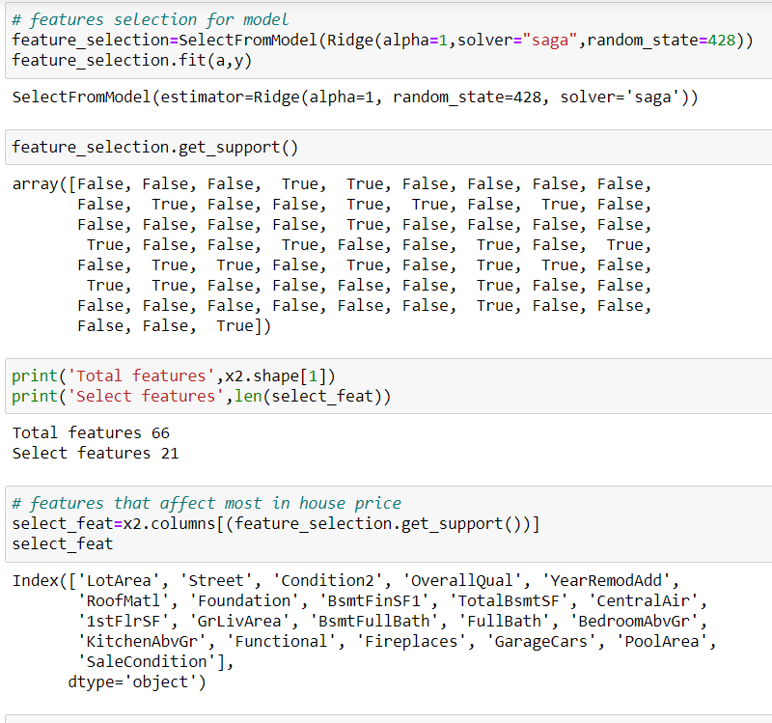
Key Findings and Conclusions of the Study
From the above code find features that most affect the house price or say key features of datasets by Lasso model because its equal weight the all features.

Slide 23
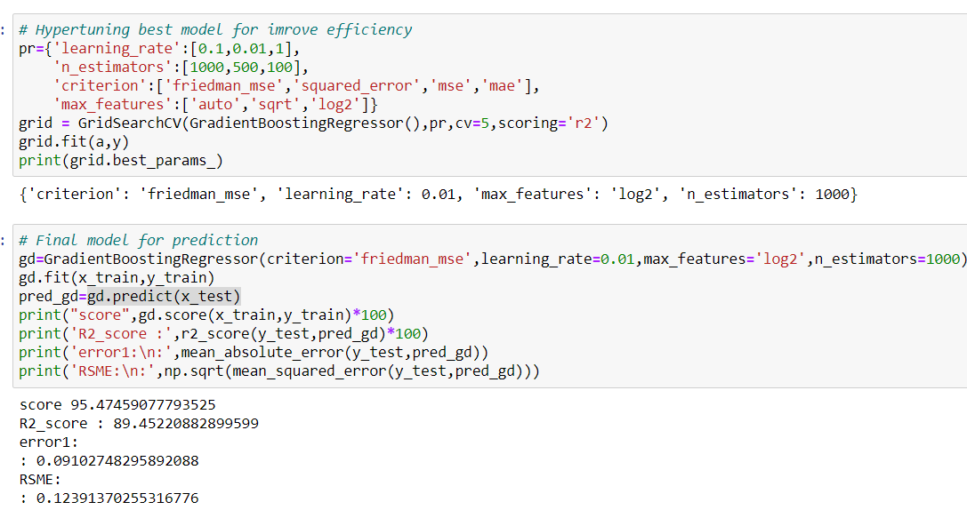
Select Best Model base Less RSME and Test score and cross validation score Gradient Boosting Algorithm working best for dataset
After data cleaning, features selection, transform the data Gradient Boosting Regressor performed well with Parameters of (“criterion='friedman_mse',learning_rate=0.01,max_features='log2',n_estimators=1000”)
Key Metrics for solving problem under consideration
Here We used Root mean squared error metrics
Absolute mean error metrics

Slide 24
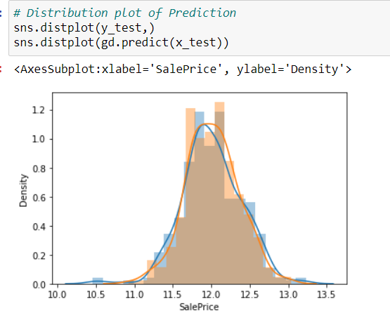
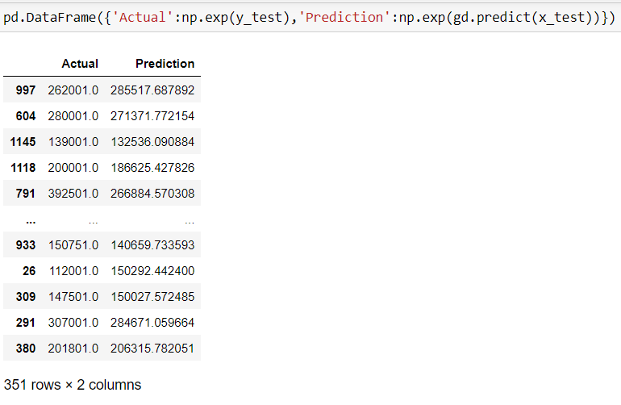
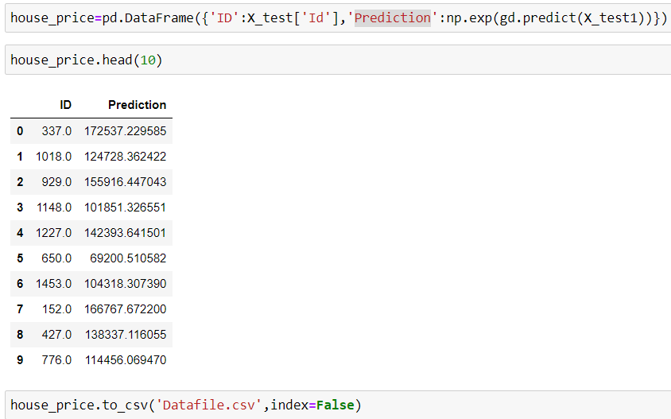
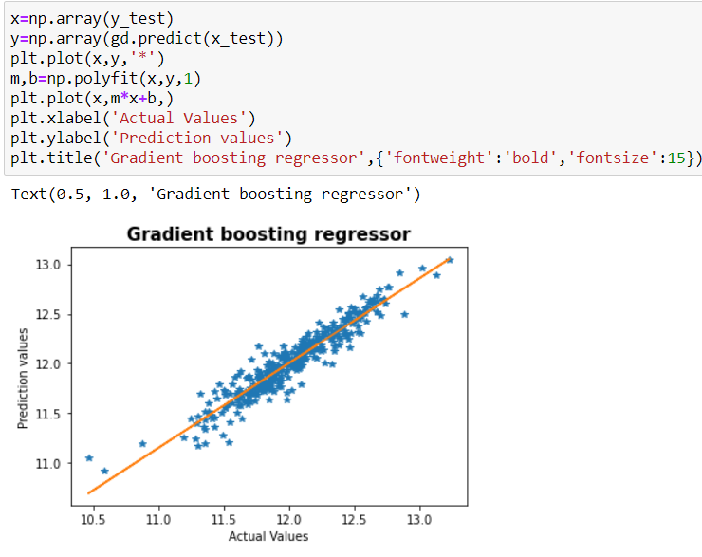
Prediction From study model

